Slide 1
ROS practice: Mapping and Follow me!
ERNI Embedded Community - November 2018
Jordi Rebull

Slide 2

Swiss Software Engineering: betterask.erni

Slide 3
Bridging the gap from simple to complex robotics

Slide 4
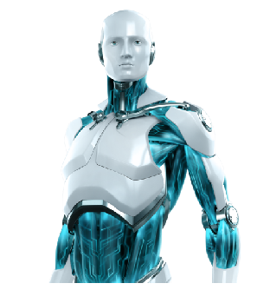
Challenges in robotics:
Robots are complex systems.
Wide diversity of robots, sensors, programming languages, etc.
World is asynchronous. Sequential programming is not suitable.

Slide 5
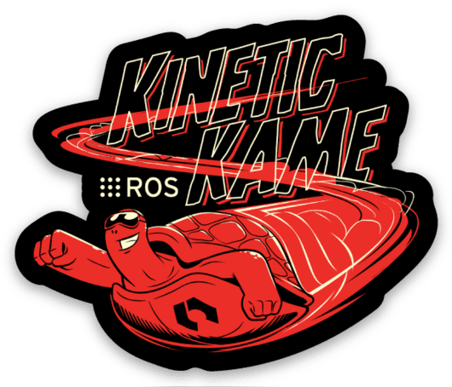

Summary
ROBOTICS NEED:
Callbacks
Separated processes that communicate through a messaging interface.
Hardware abstraction
There is a software infrastructure that enables this (among many other things) and it is called:
Swiss Software Engineering: betterask.erni

Slide 6
What is ROS?

Slide 7
What is ROS?
The Robot Operating System (ROS) is a flexible framework for writing robot software. It is a set of software libraries and tools that help to simplify the task of creating complex and robust robot applications. It provides:
Hardware abstraction
Low level device control
Message-passing between processes
Programming language independence
Implementation of a wide range of commonly used tools and algorithms
Package management
Swiss Software Engineering: betterask.erni

Slide 8
ROS philosophy
Peer to Peer. Individual programs communicate over defined API (ROS messages, services, etc.).
Distributed. Programs can be run on multiple computers and communicate over the network.
Tools based. ROS is based on a microkernel design which uses a large number of small tools to build and run various ROS components.
Multi-lingual. ROS modules can be written in any language for which a client library exists (C++, phyton, java, MATLAB, etc.).
Light-weight. Stand-alone libraries are wrapped around with a thin ROS layer.
Hardware agnostic
Free and open-source. Most ROS software is open-source and free to use
Swiss Software Engineering: betterask.erni

Slide 9
ROS architecture

Slide 10

ROS architecture
ROS architecture can be described at three different levels:
Computation graph level: covers the peer-to-peer network of ROS processes, roles and communications.
Filesystem level: describes how ROS is organized and configured
Community level: describes the resources available to exchange software and knowledge across different communities.
Swiss Software Engineering: betterask.erni

Slide 11
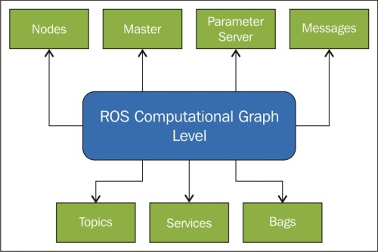
ROS computation graph level
Swiss Software Engineering: betterask.erni

Slide 12
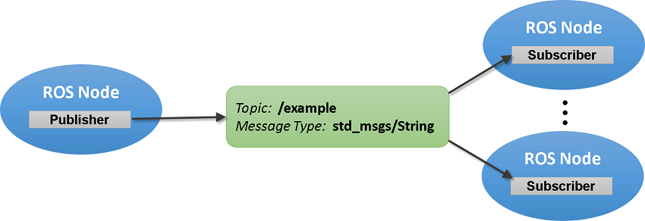
ROS computation graph level - Concepts
Nodes: Nodes are processes that performs computation. Typical examples are sensor drivers, actuator drivers, high level algorithms, user interfaces, etc. A robot system usually comprises many nodes.
Messages: A data structure used to communicate between nodes.
Topics: A node sends out a message by publishing it to a given topic. The topic is a name that is used to identify the content of the message.
Swiss Software Engineering: betterask.erni

Slide 13
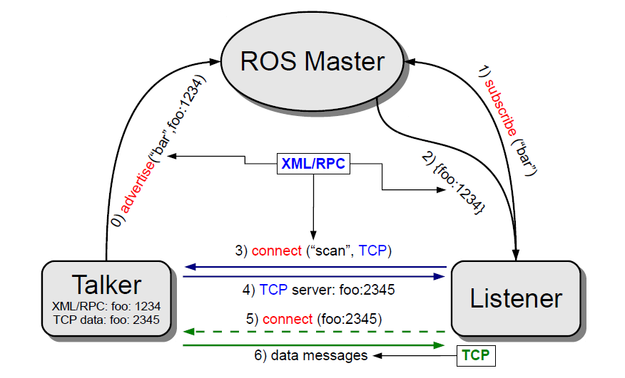
ROS computation graph level – The Master
Master: Provides name registration and lookup to the rest of the computation graph. Without the master, nodes would not be able to find each other, exchange messages or invoke services.
Swiss Software Engineering: betterask.erni

Slide 14
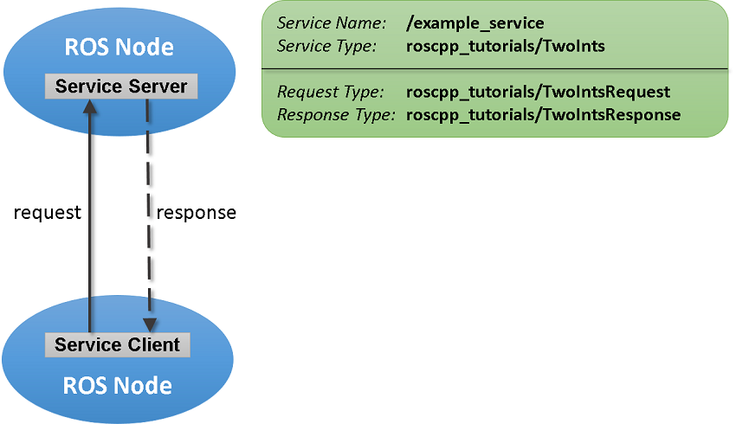
ROS computation graph level – Services
Services: The publish/subscribe model is a very flexible communication paradigm but it is not appropriate for request/reply interactions (which are often required in a distributed system). Request/reply is done via services.
Swiss Software Engineering: betterask.erni

Slide 15
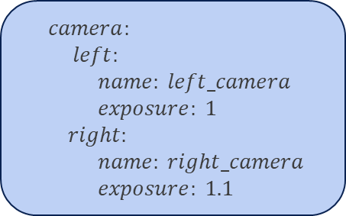
ROS computation graph level – Concepts
Bags: A format for saving and playing back ROS message data. Bags are an important mechanism for storing data, such as sensor data, that can be difficult to collect but is necessary for developing and testing algorithms.
Parameter server: Allows data to be stored by key in a central location. It is currently part of the Master. It is used for static data such as configuration parameters. Parameters can be defined in .yaml files.
$$Config.yaml$$
$camera:$
$left:$
$name: left_camera$
$exposure: 1$
$right:$
$name: right_camera$
$exposure: 1.1$
Swiss Software Engineering: betterask.erni

Slide 16
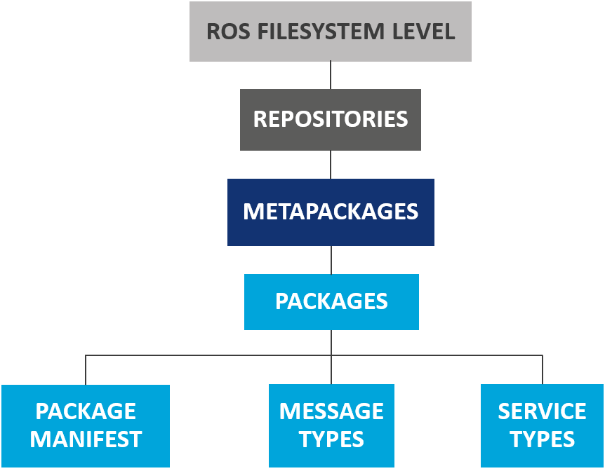
ROS filesystem level
A collection of packages which share a common VCS system
Main unit for organizing code in ROS. It contains runtime processes, ROS-dependent libraries, configuration files, etc. The most granular thing you can build and release is a package
Special packages which only serve to represent a group of packages
Service description. Define the request and response data structures for ROS services
Package metadata, including its name, version, description, license, dependencies, etc.
Message description. Define the data structures for ROS messages
Swiss Software Engineering: betterask.erni

Slide 17


ROS filesystem level – Package structure
Package_name
src
CMakeLists.txt
package.xml
msg
srv
include
launch
MANDATORY
OPTIONAL
Swiss Software Engineering: betterask.erni

Slide 18
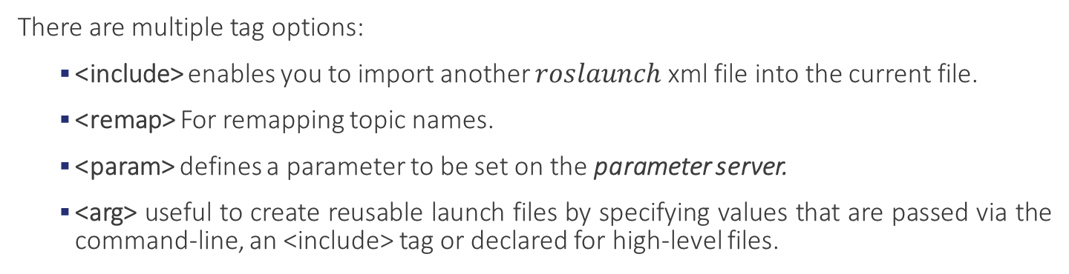
ROS filesystem level – Launch files
ROS launch is a tool for launching multiple nodes. Are written in XML as *.launch files. If not yet running, ROS launch automatically starts the master.
$$Simple launch file example$$
There are multiple tag options:
<include> enables you to import another $roslaunch$ xml file into the current file.
<remap> For remapping topic names.
<param> defines a parameter to be set on the parameter server.
<arg> useful to create reusable launch files by specifying values that are passed via the command-line, an <include> tag or declared for high-level files.
Swiss Software Engineering: betterask.erni

Slide 19
ROS Community level
Distributions. ROS distributions are collection of versioned stacks that you can install.
Repositories. ROS relies on a federated network of code repositories.
The ROS wiki. http://wiki.ros.org/Documentation main forum for documenting information about ROS.
Bug Ticket System. http://wiki.ros.org/Tickets
Mailing Lists. http://wiki.ros.org/Support primary communication channel about new updates.
ROS answers. https://answers.ros.org/questions/
Blog. http://www.ros.org/news/
Swiss Software Engineering: betterask.erni

Slide 20
ROS Tools and Commands

Slide 21
ROS Commands (I)
Filesystem management commands
$ catkin_create_pkg <package_name> [depend1] [depend2]
Creates a new ROS package
$ catkin_make
Builds a ROS catkin workspace
$ roscd <package_name>
Change directory to a package
Start-up commands
$ roscore
The basis nodes for ROS-based systems
$ rosrun <package_name> <node_name>
Runs a ROS package’s executable
$ roslaunch <package_name> <launch_file_name>
Starts a roscore (if needed), multiple nodes and set parameter server parameters
Swiss Software Engineering: betterask.erni

Slide 22
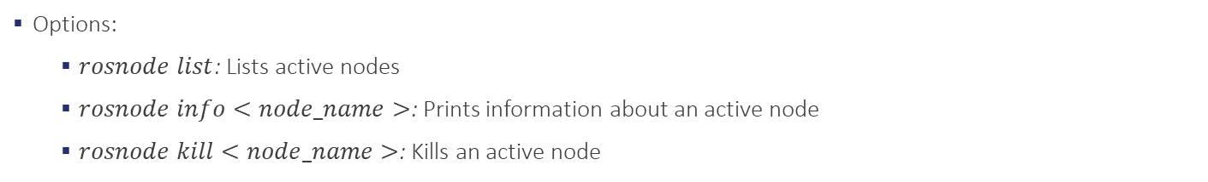
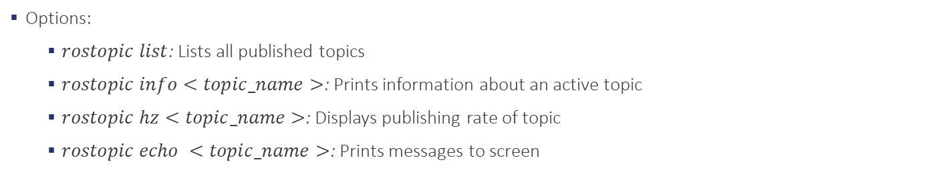
ROS Commands (II)
Introspection commands
$ rosnode
Displays debugging information about ROS nodes
Options:
$rosnode list$: Lists active nodes
$rosnode info<node_name>$: Prints information about an active node
$rosnode kill<node_name>$: Kills an active node
$ rostopic
Displays information about ROS topics
Options:
$rostopic list$: Lists all published topics
$rostopic info<topic_name>$: Prints information about an active topic
$rostopic hz<topic_name>$: Displays publishing rate of topic
$rostopic echo <topic_name>$: Prints messages to screen
Swiss Software Engineering: betterask.erni

Slide 23
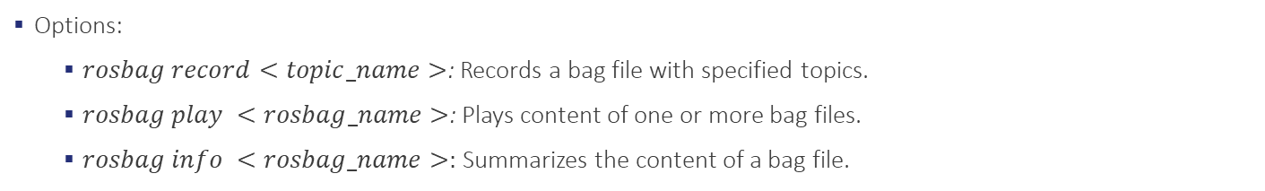
ROS Commands (III)
Logging commands
$ rosbag
A set of tools for recording and playing back ROS topics
Options:
$rosbag record<topic_name>$: Records a bag file with specified topics.
$rosbag play <rosbag_name>$: Plays content of one or more bag files.
$rosbag info <rosbag_name>:$ Summarizes the content of a bag file.
Almost all ROS commands and tools in a single document:
https://github.com/ros/cheatsheet/releases/download/0.0.1/ROScheatsheet_catkin.pdf
Wiki for all ROS commands and tools:
http://wiki.ros.org/ROS/CommandLineTools
Swiss Software Engineering: betterask.erni

Slide 24
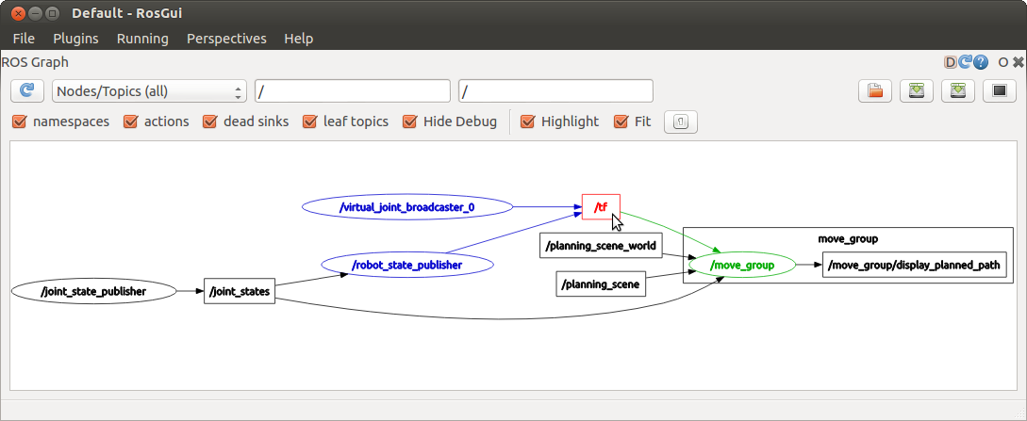
ROS Tools - rqt_graph
rqt_graph provides a GUI plugin for visualizing the ROS computation graph.
Swiss Software Engineering: betterask.erni

Slide 25
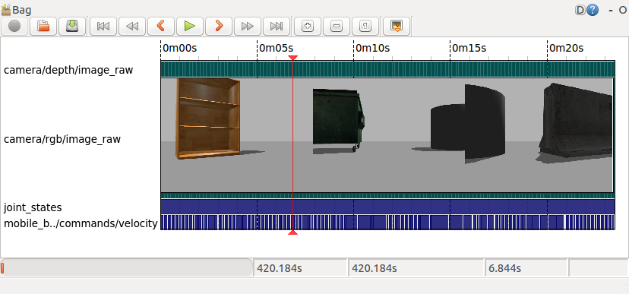
ROS Tools - rqt_bag
rqt_bag provides a GUI plugin for displaying and replaying ROS bag files.
Swiss Software Engineering: betterask.erni

Slide 26
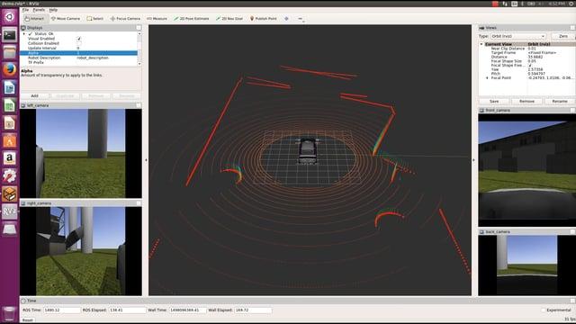
ROS Tools - RVIZ
Swiss Software Engineering: betterask.erni
3D visualization tool for ROS

Slide 27



